Slide 1
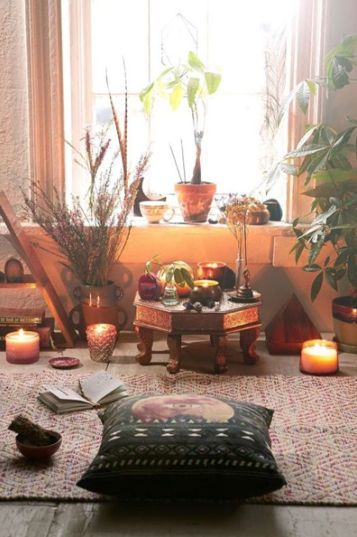
CREATING MIRACLES Lesson 4: Creating your sacred manifestation space!
Become Kick-Ass!

Slide 2
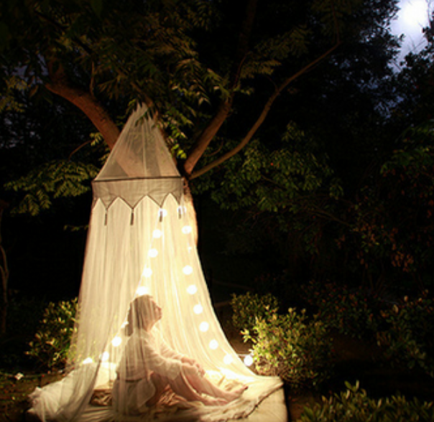
CREATING MIRACLES Lesson 4: Creating your sacred manifestation space
Become Kick-Ass!
What is a sacred manifestation space?
A sacred space is a physical place and time set aside for you where you will utilize all your senses to create your desires.

Slide 3
CREATING MIRACLES Lesson 4: Creating your sacred manifestation space
Become Kick-Ass!
What are the benefits of a sacred space?
- Find out what is happening inside of you: recognize if there's fear/anxiety/euphoria
- Find your peace/center again
- Focus consciously on what you want
- Turn away from what you don't want
- Create the reality that you want!

Slide 4
CREATING MIRACLES Lesson 4: Creating your sacred manifestation space
Become Kick-Ass!
Why do we need one?
Without a conscious effort from our part:
- we are running on auto-pilot creating what we've been creating so far
- we are experiencing the same emotions over and over again
- we are having the same thoughts over and over again
- we get caught up with busyness and bad news of the day

Slide 5
CREATING MIRACLES Lesson 4: Creating your sacred manifestation space
Become Kick-Ass!
Characteristics
- Same place everytime
- Where you feel safe
- Comfortable, inviting, orderly
- Pleasant temperature
- Pleasant lighting
- Pleasant view

Slide 6
CREATING MIRACLES Lesson 4: Creating your sacred manifestation space
Become Kick-Ass!
Preparation
- Set aside approximately 30 minutes of uninterrupted time just for you (mobile phone on flight mode)
- Play some soothing background music
- Be silent for 10 minutes to clear your heart and mind
- Focus on your breadth and allow yourself time to relax
- Have pen and paper at hand

Slide 7
CREATING MIRACLES Lesson 4: Creating your sacred manifestation space
Become Kick-Ass!
What to bring
- For your eyes: a vision board/movie/book/card/photo...
- For your ears: your voice/meditation/recording...
- For your tastebuds: a soothing cup of tea/a glass of wine
- For your touch: a piece of clothing/fabric/money/ microphone/award/...
- For your nose: a perfumed candle/aromatherapy/male perfume...

Slide 8
CREATING MIRACLES Lesson 4: Creating your sacred manifestation space
Become Kick-Ass!
EXERCISE: plan ahead what to bring
- For your eyes: ____________________________
- For your ears: _____________________________
- For your tastebuds: ____________________________
- For your skin: _______________________________
- For your nose: ________________________________

Slide 9
CREATING MIRACLES Lesson 4: Creating your sacred manifestation space
Become Kick-Ass!
How do you create?
- Imagine things into existence (thoughts/visualization)
- Speak things into existence (affirmations/story/declaration)
- Feel things into existence (what emotion do you need?
e.g. tenderness, passion, power, pride, determination, intelligence, gratitude, love)

Slide 10
CREATING MIRACLES Lesson 4: Creating your sacred manifestation space
Become Kick-Ass!
How do you create? Continued
- Write things into existence (journal/empty your soul/write a letter to yourself dated in the future/write a letter to a friend...)
- Write a to-do list
- Determine steps to take that day - no matter how tiny

Slide 11
CREATING MIRACLES Lesson 4: Creating your sacred manifestation space
Become Kick-Ass!
Exercise
What will you name your sacred space?
At what time of the day will you create?
What will you focus your creative powers on?

Slide 12
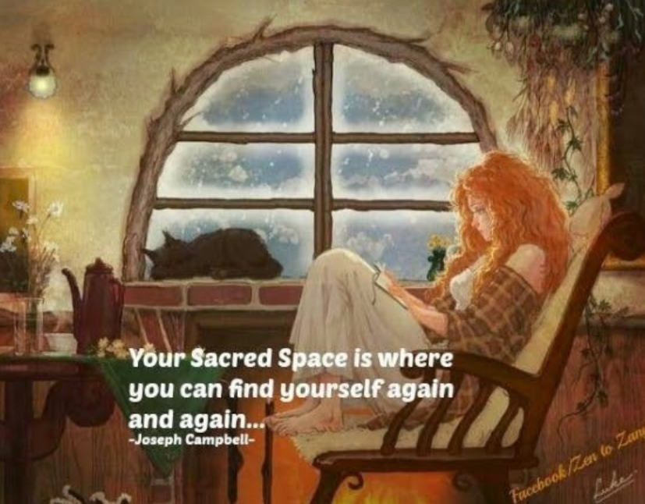
CREATING MIRACLES Lesson 4: Creating your sacred manifestation space
Become Kick-Ass!

